Slide 1
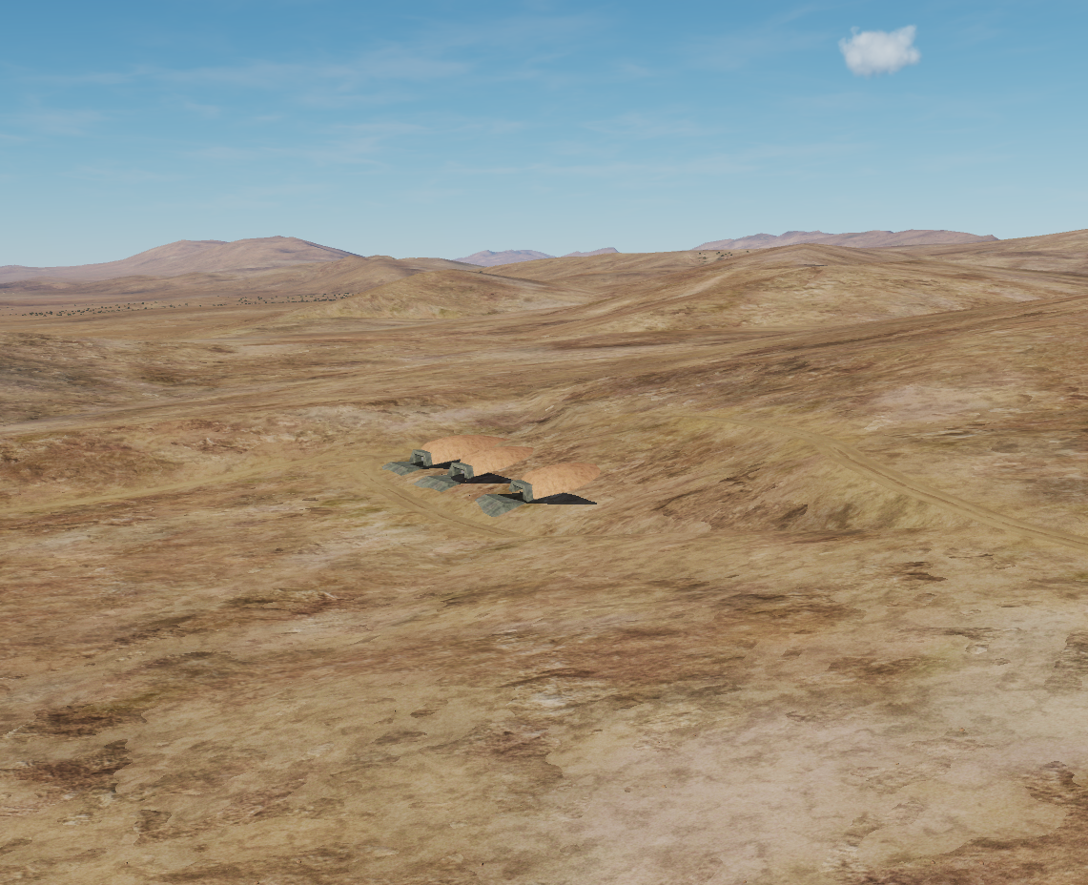
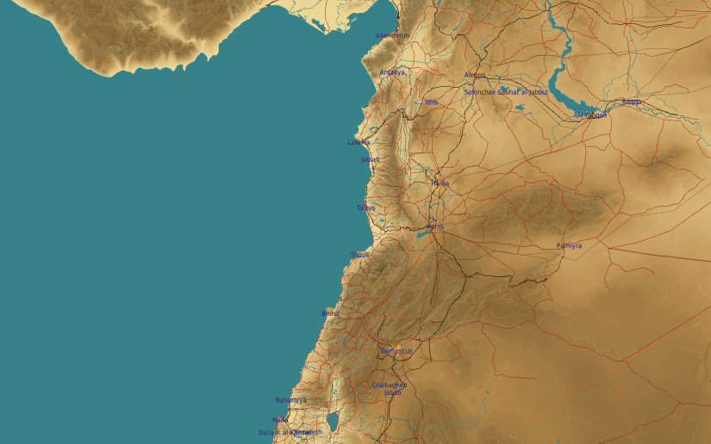
OPARTGT057 Chemical Weapon storage
N
57
3
2
1
DESCRIPTION OF THE DESIRED POINTS OF IMPACT WITH WPN TYPE:
OPARTGT057A– Storage Bunkers
DPI 1 N33 40.455 E036 45.382/2723ft/(2000 Ibs bomb)
DPI 2 N33 40.474 E036 45.398/2719ft/(2000 Ibs bomb)
DPI 3 N33 40.491 E036 45.413/2707ft/2000 lbs bomb)
Chemical Weapon Storage Bunkers
OPARTGT057 – Earth covered bunkers made of concrete slab supported by reinforced concrete base and pillars, flat poured roof, requires delayed fuzing.
Suggested fuzing solution on DPIs 1-3 – contact to open up the roof followed by delayed to pierce through floors and affect building structure and contents.
8

